Slide 1


Rohan & Yash Present
HOMESEEKER
Your Dream Home
CE446 – SUMMER INTERNSHIP - II

Slide 2
INTRODUCTION
HELLO THERE!
“HomeSeeker" provides solution to new residents in particular city for finding out the property. The goal of project is to give platform to broker for managing the purchase and sell of properties.

Slide 3

WHY THIS PROJECT !!!
There is so many property deal is done every day where is manual system is used for selling and buying property. Post covid-19,we need less physical contact.

Slide 4

TOOLS AND TECHNOLOGY USED
Front-end
HTML
CSS
JavaScript
Back-end
Django Postgresql

Slide 5

FUNCTIONALITY
Realtor Registration
Add New Property
Update Property Detils
Delete Property
Realtor Registration
User Registration
View Property
Make an inquiry

Slide 6

HOW TO USE

Slide 7

1
REALTOR REGISTRATION
REALTOR CAN CONNECT WITH ADMIN AND PROVIDE THE REQUIRED DETAILS SO ADMIN CAN REGISTER REALTOR AND UPLOAD NECESSARY DETAILS.

Slide 8
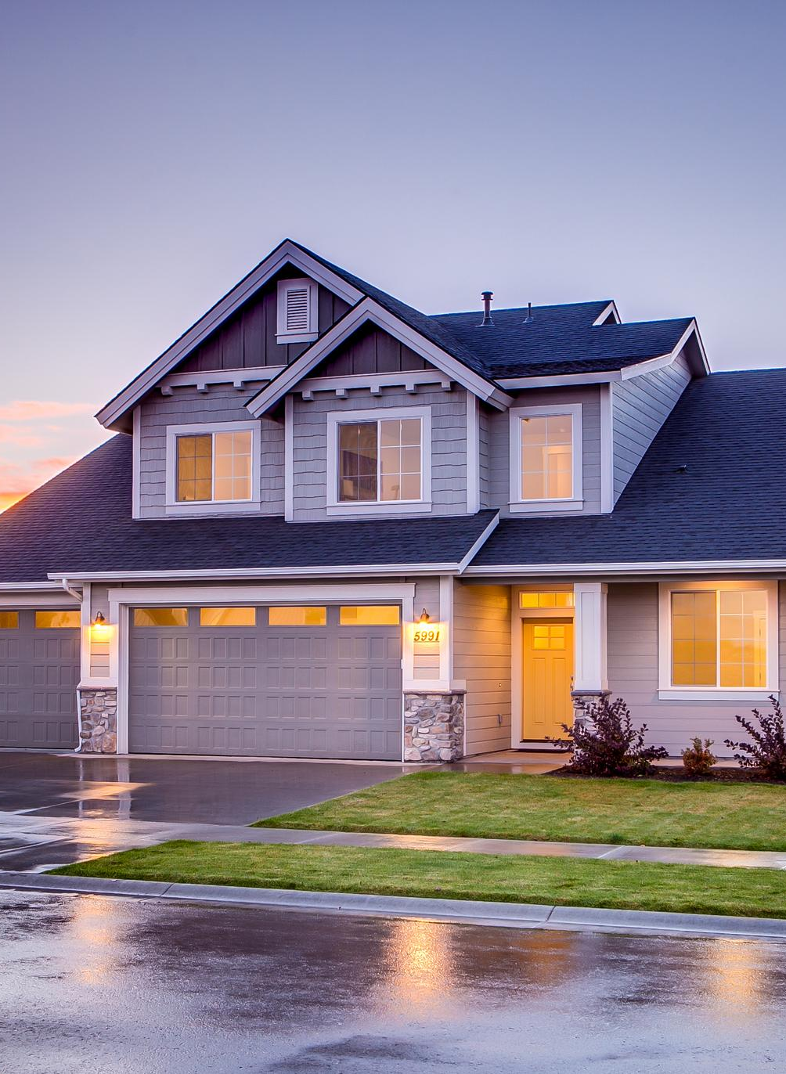
2. ADD NEW PROPERTY
for adding new property provide the following details to admin
Title of property
Address
City
State
Zipcode
Description
No of Bedroom
No of Bathroom
Price
Outrage
Square Ft.
Image of Property

Slide 9

3
CUSTOMER
Customer can directly register to website user their email or google account.
Customer can apply various filters on location, price, type etc. and match with their requirements and if they like property they can connect with realtor.

Slide 10

Lets see how it look like

Slide 11
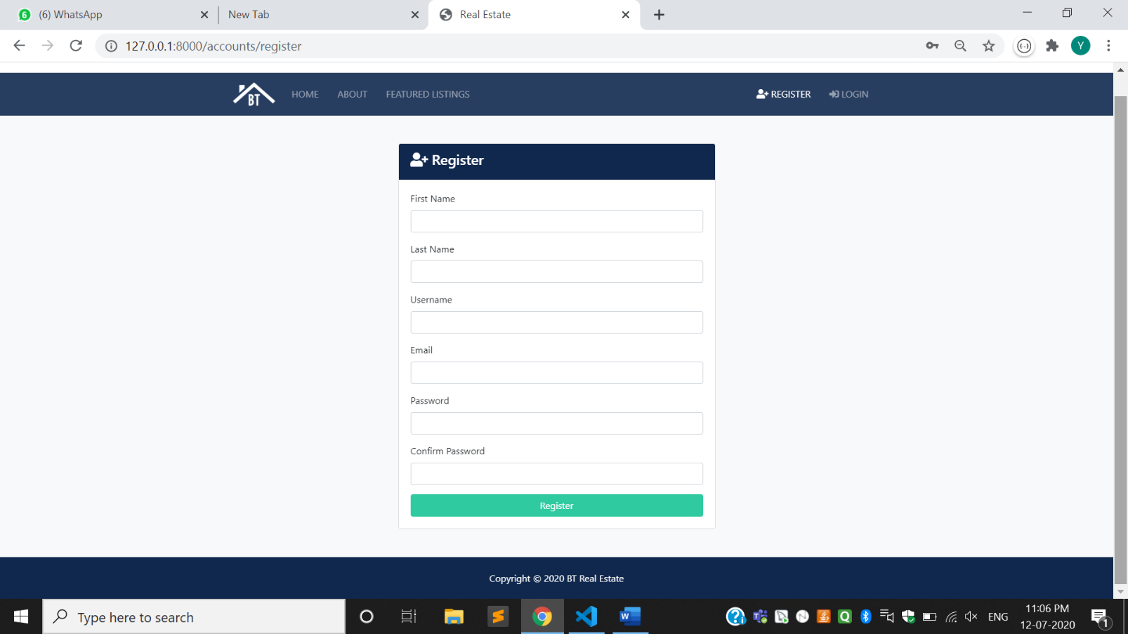
Customer Registration

Slide 12
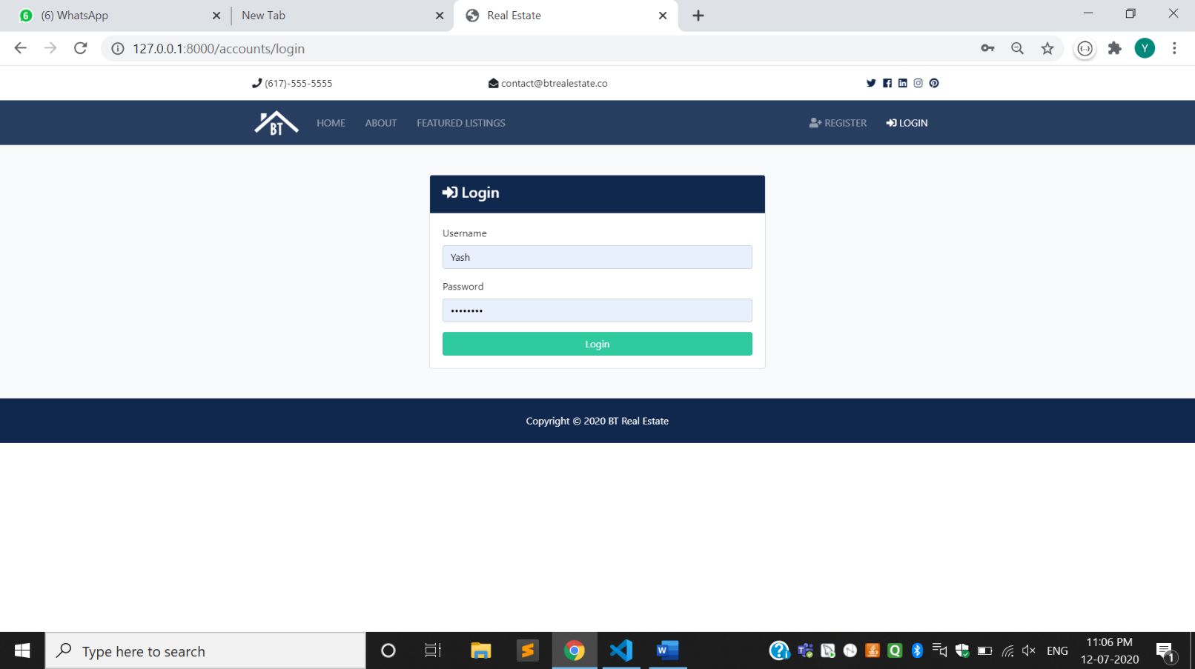
User Login

Slide 13
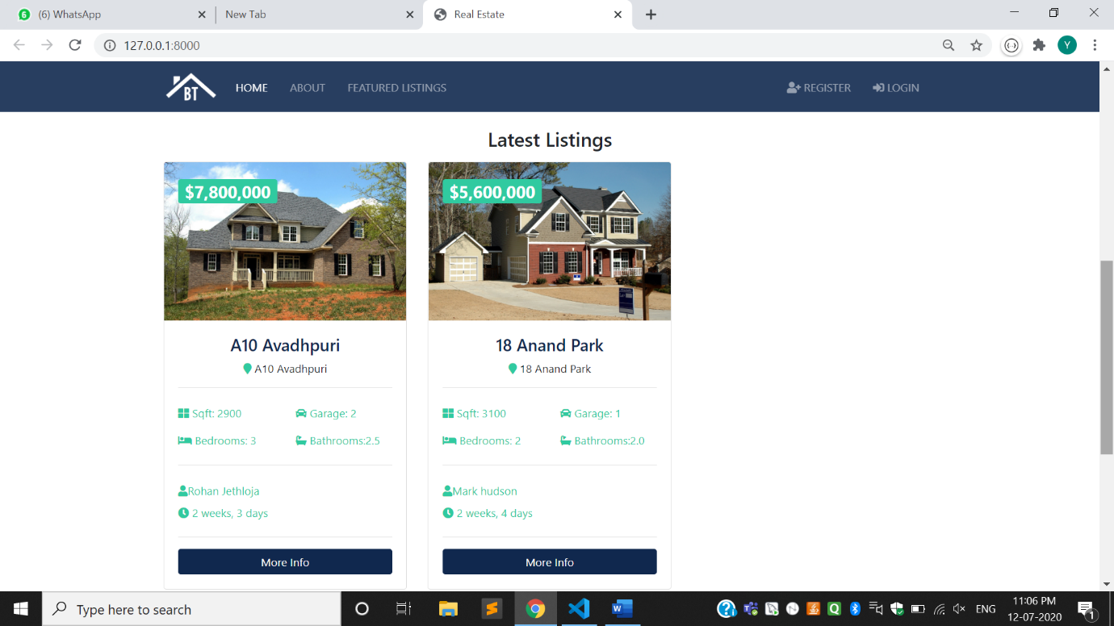
Home Page

Slide 14
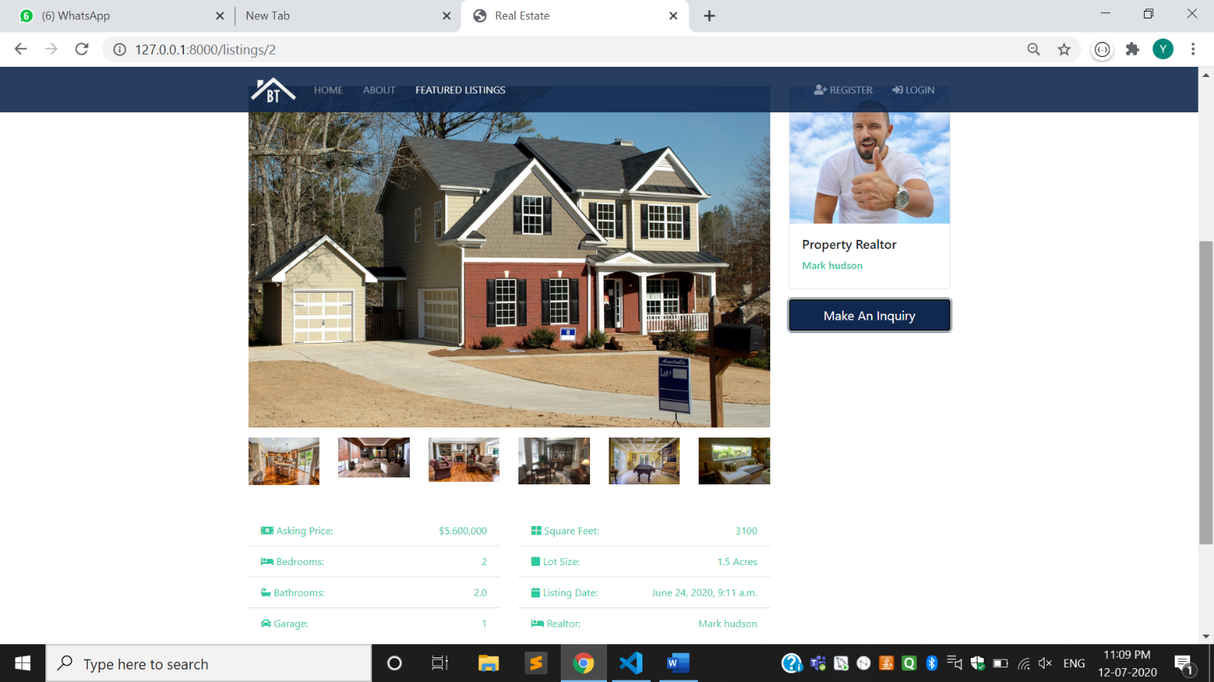
Property Details

Slide 15
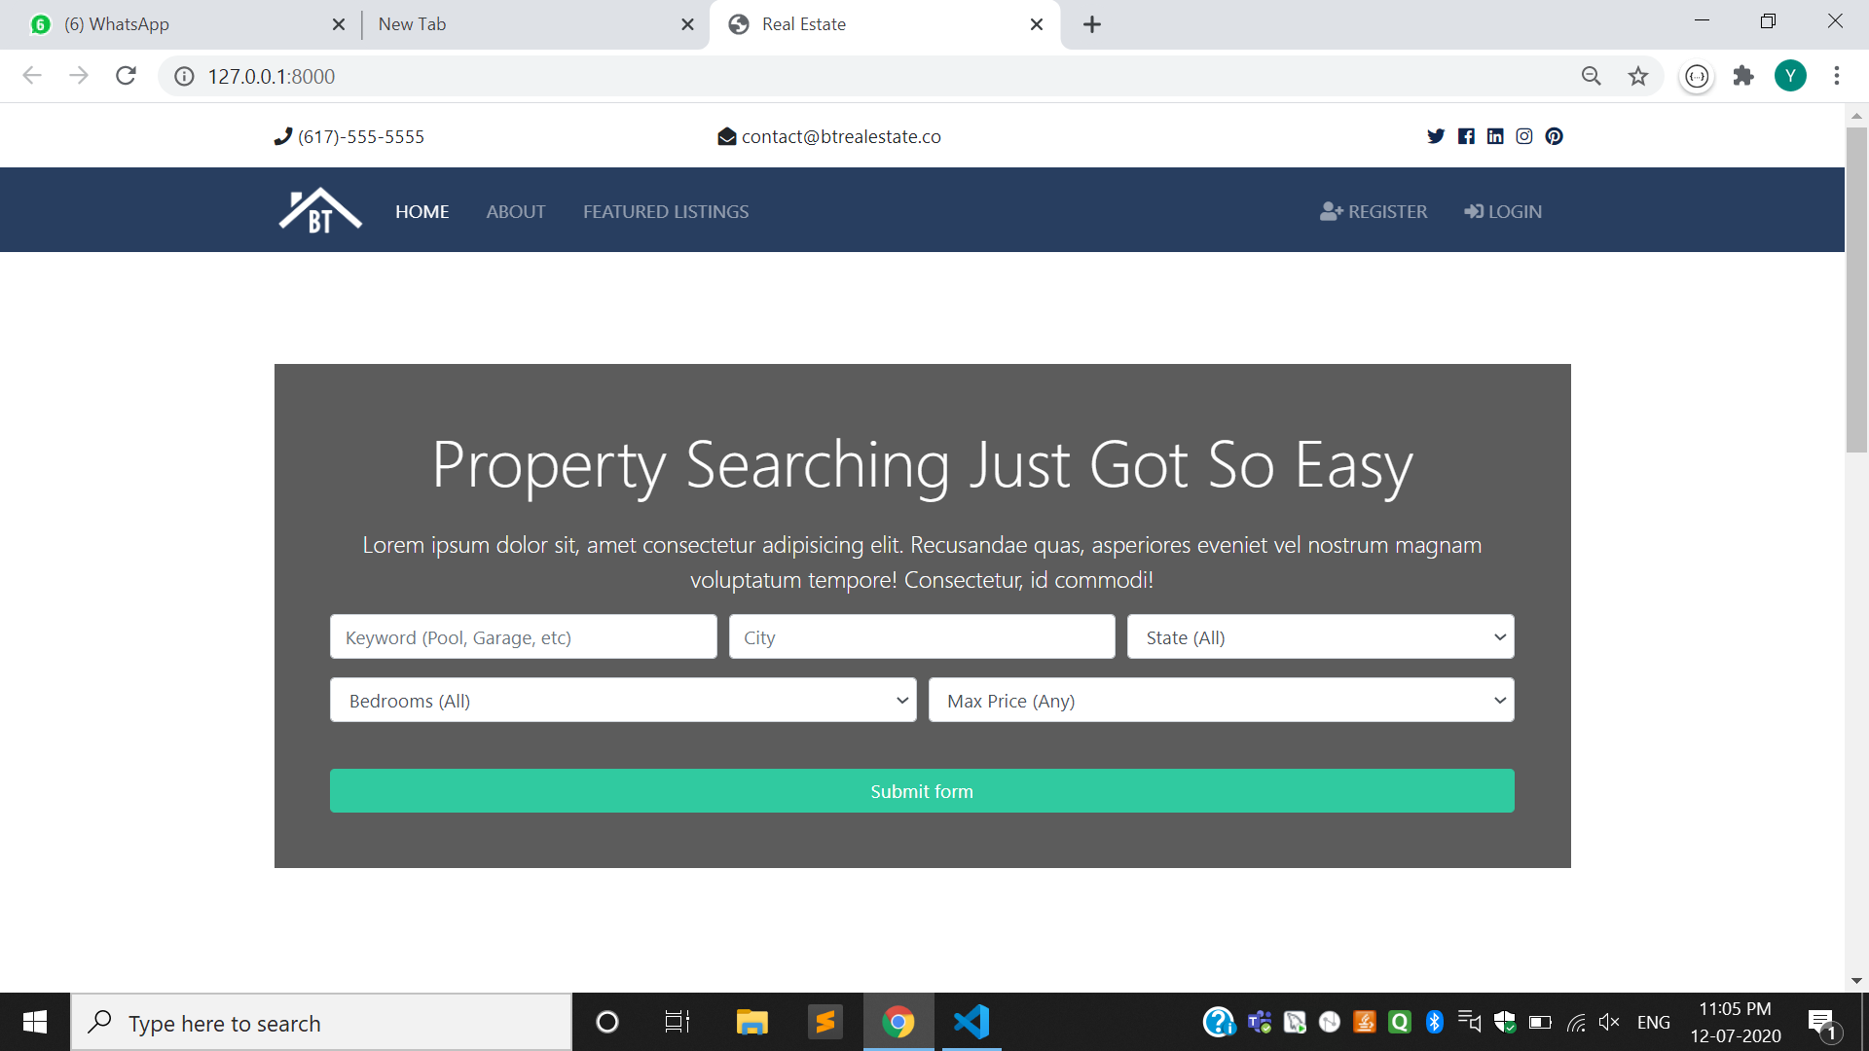
Property Filtration

Slide 16
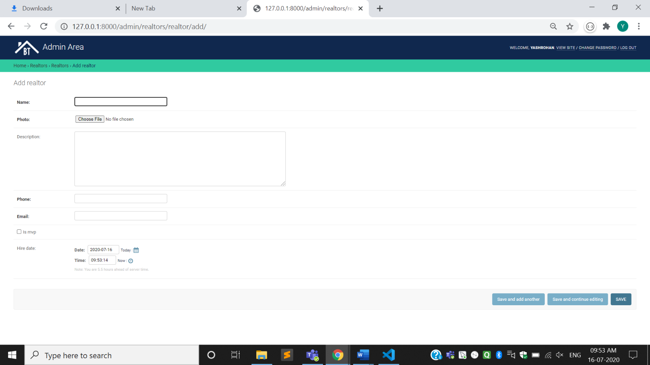
Add new Realtor

Slide 17
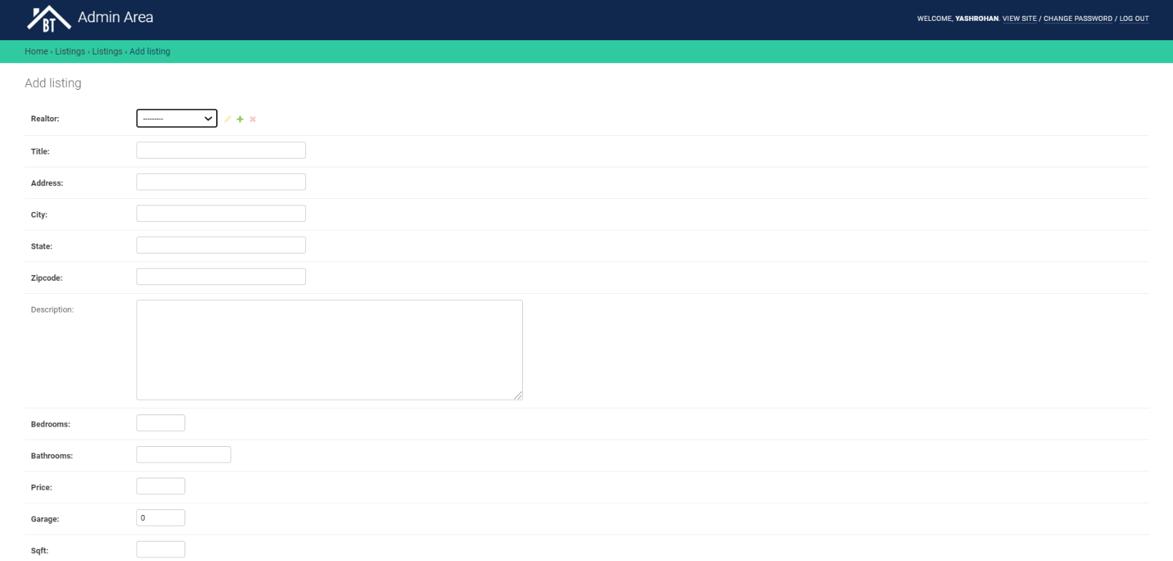
Add new Listing

Slide 18
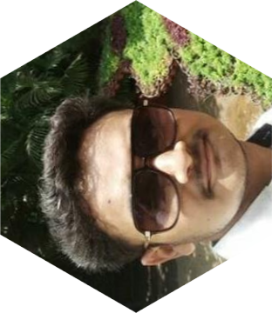


HomeSeeker Your Dream Home
Real Estate Management System
Problems Addressed:
“HomeSeeker" provides solution to new residents in particular city for finding out the property. The goal of project is to give platform to broker for managing the purchase and sell of properties.
HTML, CSS, JavaScript, Django Postgresql

Slide 19

THANK YOU FOR YOUR TIME!
CONTACT US
+91 9624764349
+91 9909194973
17ce007@harusat.edu.in
17ce037@charusat.edu.in
Charusat University, Changa

